Slide 1
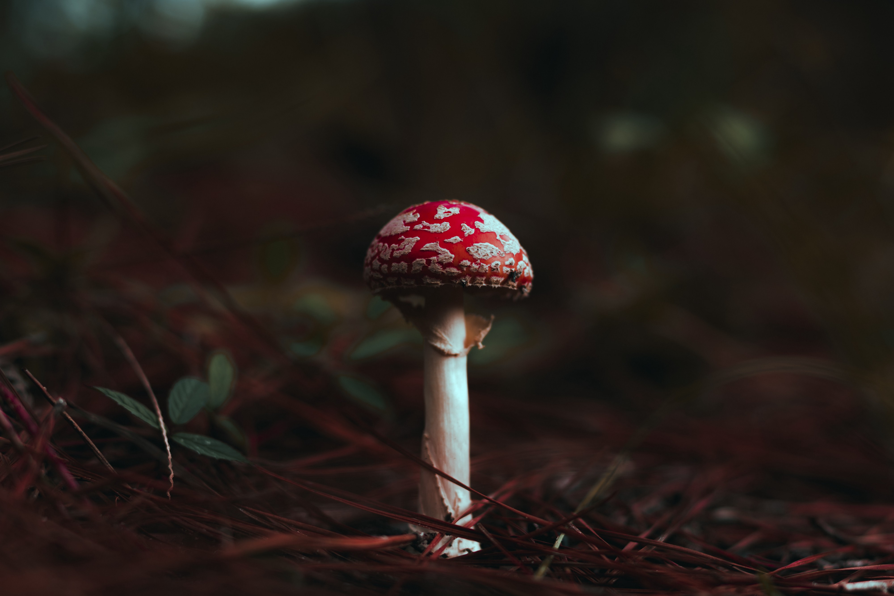
Mushroom Classification
Group Members:
Shaurya Negi
Krish Shah
Reshma
Rishab Mahajan

Slide 2
Content
Problem Statement
Dataset Description
Data cleaning
Exploratory Data Analysis
Feature Scaling
Principal Component Analysis
Data Modelling
Results

Slide 3
Problem statement
In recent years, the popularity of mushrooms as a superfood and the understanding of their vast health benefits has surged. What used to be typically seen as just a traditional food, mushrooms are now being widely consumed and acknowledged for their healing and health abilities. With more and more people interested, foraging for mushrooms in the wild is likely to increase and we wanted to understand if edible/poisonous mushrooms could be easily identified not only aid .
This project aims at developing a machine-learning algorithm that will determine if a certain mushroom is edible or poisonous by its specifications like cap shape, cap color, gill color, etc. using different classifiers.

Slide 4
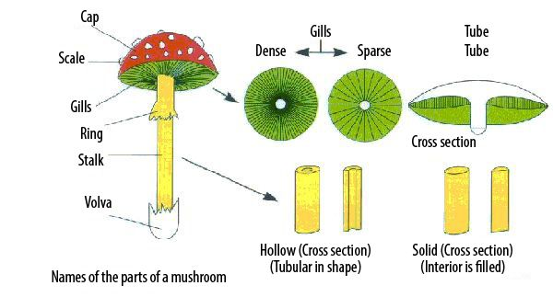
Structure of Mushroom

Slide 5
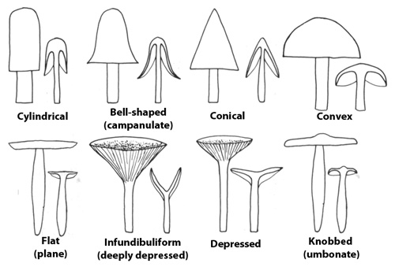
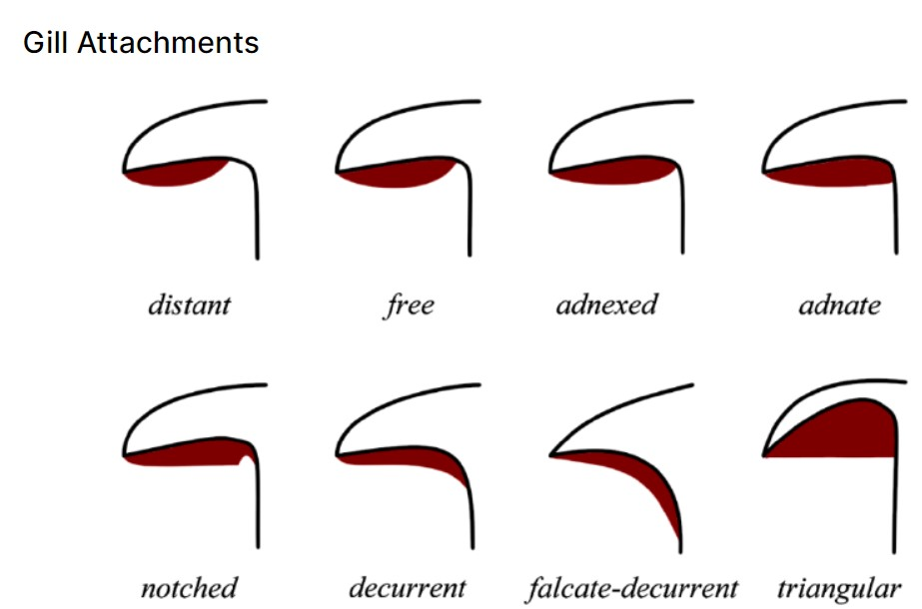
Types of Cap Shapes
Gill Attachments

Slide 6
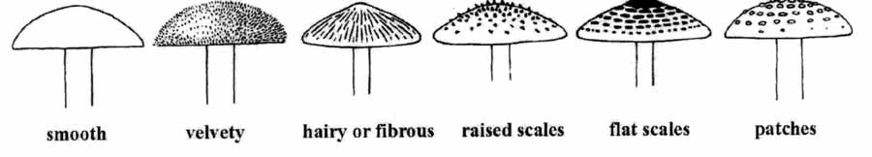
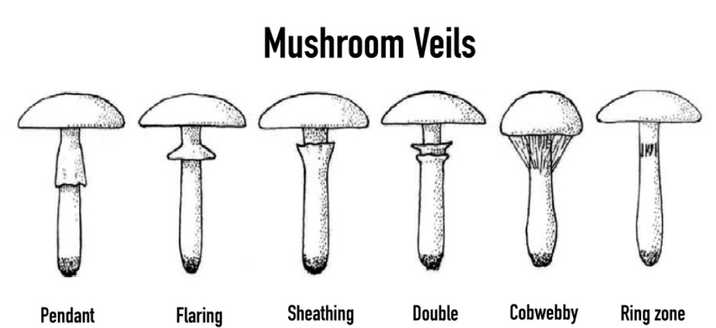
Type of Mushroom Surfaces

Slide 7
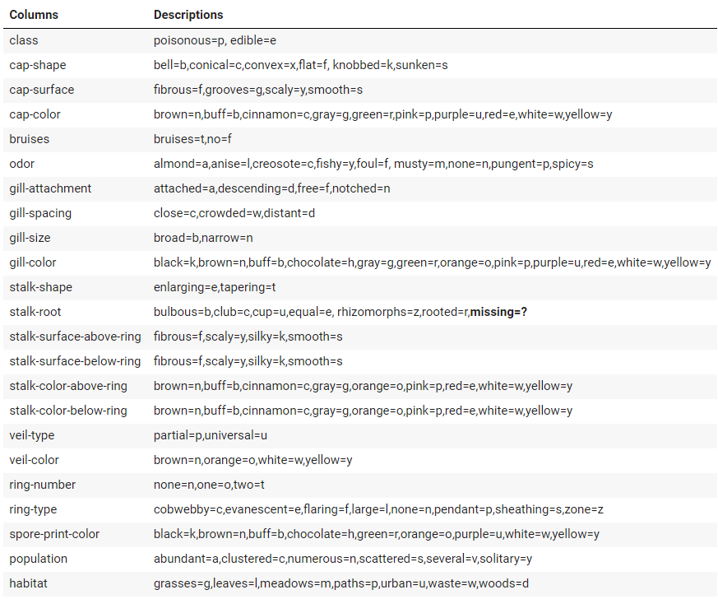
Dataset Description
The mushroom dataset includes descriptions of hypothetical samples corresponding to 23 species.
Each species is identified as definitely edible, definitely poisonous.
Hence, the task given is a binary classification problem whereby, given the features of mushrooms, we are to classify the mushrooms into p=Poisonous or e=edible.

Slide 8
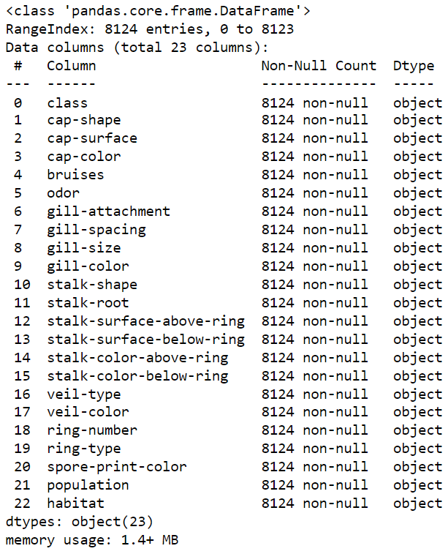
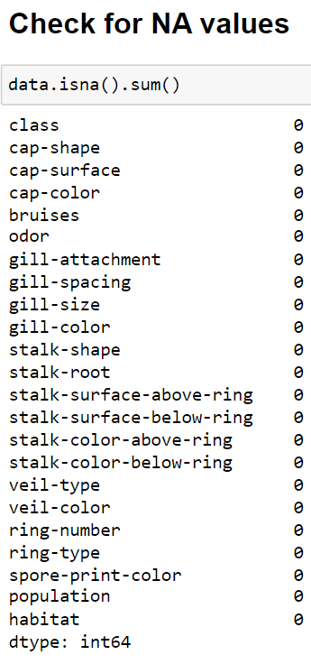
This dataset contains 22 attributes with 8124 instances of mushrooms. Figure below gives the attribute information of the dataset.
Absence of null values in the dataset

Slide 9
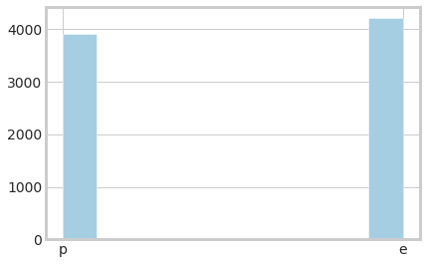
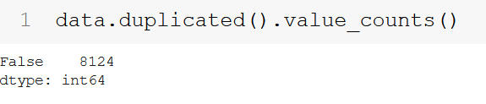
DATA DESCRIPTION (CONTD.)
As we can see from the plot, our data is balanced. Therefore, we do not need to think about oversampling/undersampling data or use SMOTE.
There are no outliers in our data as all of our features are categories and we would one hot encode them later.
We do not have any duplicate rows/columns in our data.

Slide 10
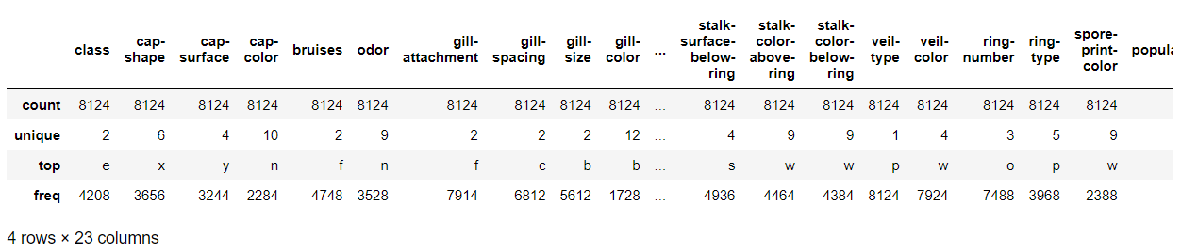
Why Feature ‘Veil-type was dropped ?
As we can observe ‘veil-type’ feature has only one unique, thereby having no contribution towards modelling.

Slide 11
Exploratory Data Analysis
Since all our columns are encoded in string and are categorical, one way to explore the values is number of unique values in each columns.
Constant Value Column(1 Unique Value): | "veil-type"
Binary Columns(2 Unique Values): | "is-edible"(label), "bruises", "gill-attachment", "gill-spacing", "gill-size", "stalk-shape"
Nominal Categorical Columns(>2 Unique Values): | "cap-shape", "cap-surface", "cap-color", "odor", "gill-color", "stalk-root", "stalk-surface-above-ring", "stalk-surface-below-ring", "stalk-color-above-ring", "stalk-color-below-ring", "veil-color", "ring-type", "spore-print-color", "population", "habitat", "ring-number"
Discrete Numerical Columns(Countable Values): | None

Slide 12
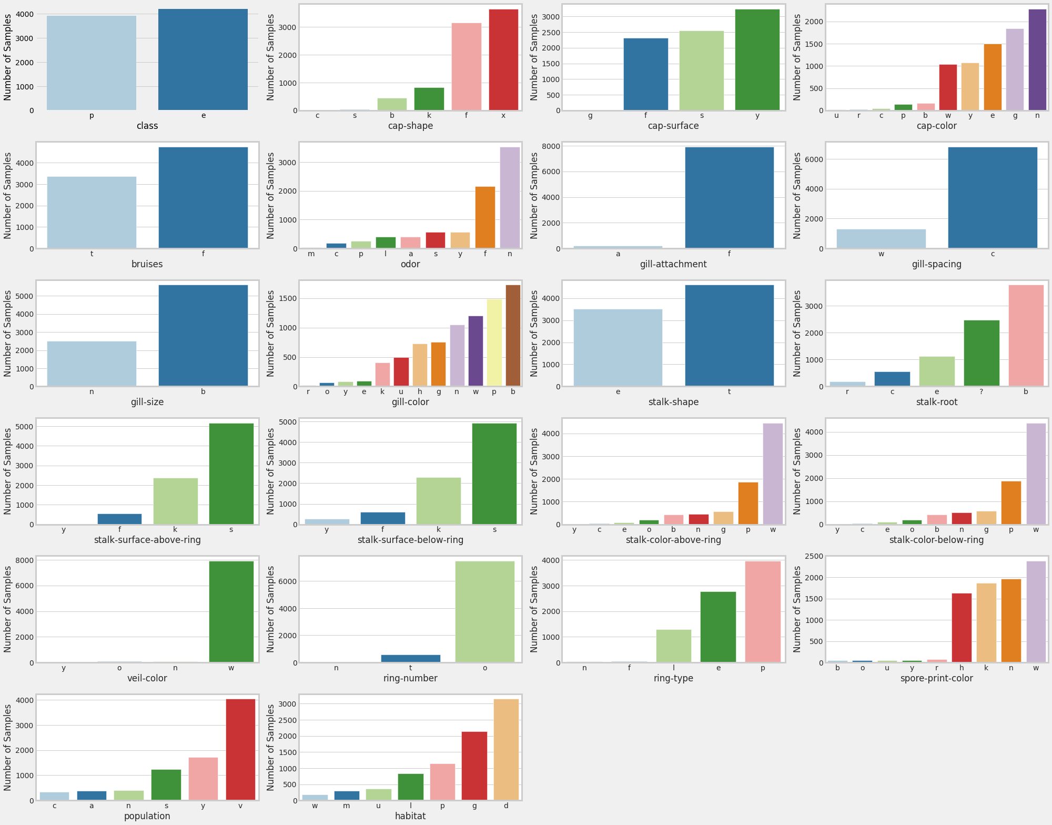
SUBPLOTS

Slide 13
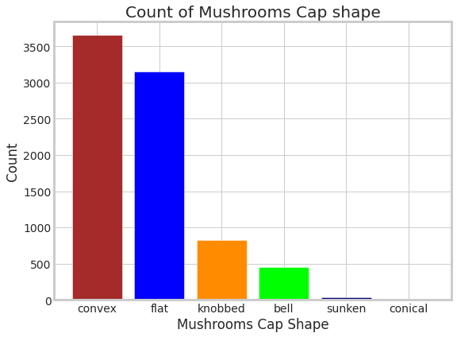
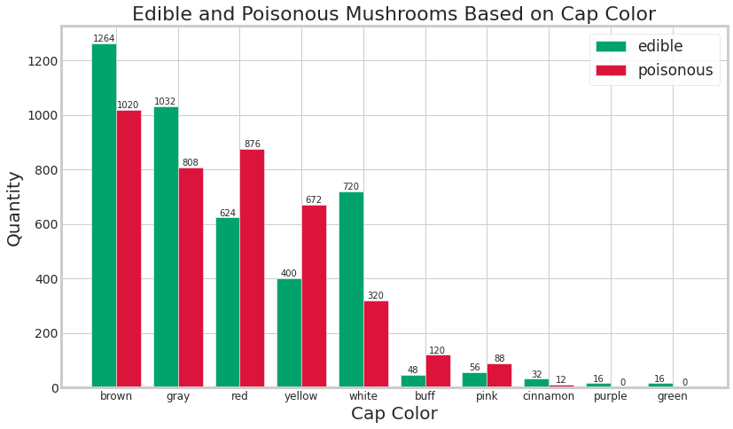
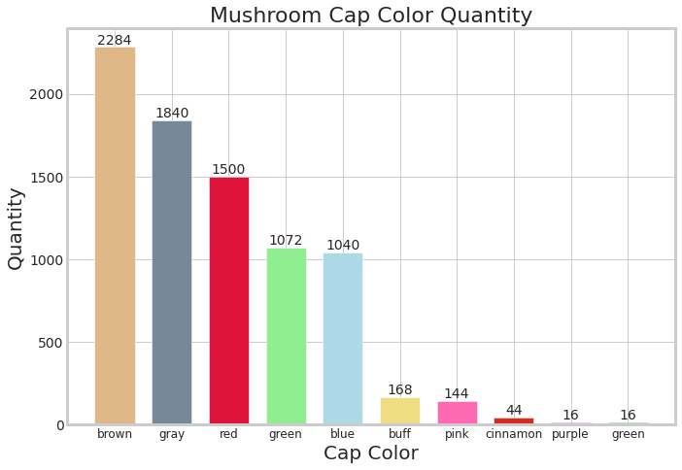

Slide 14
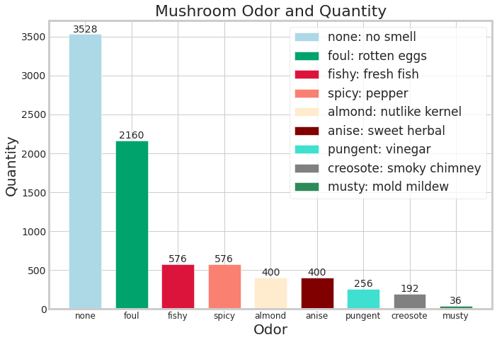
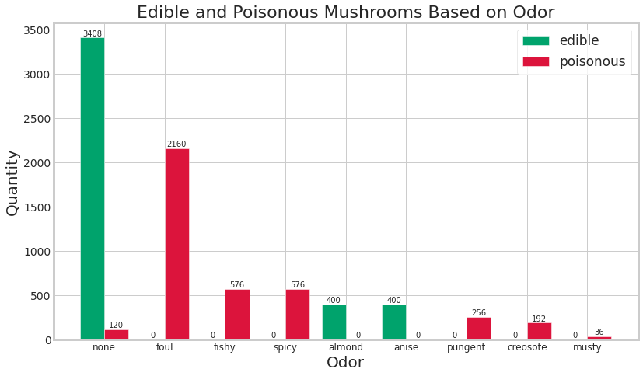
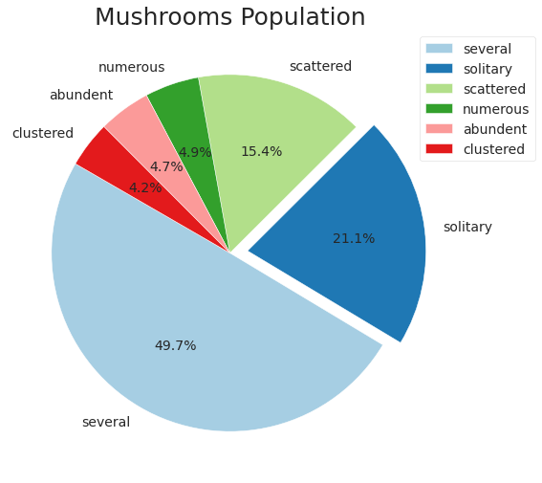
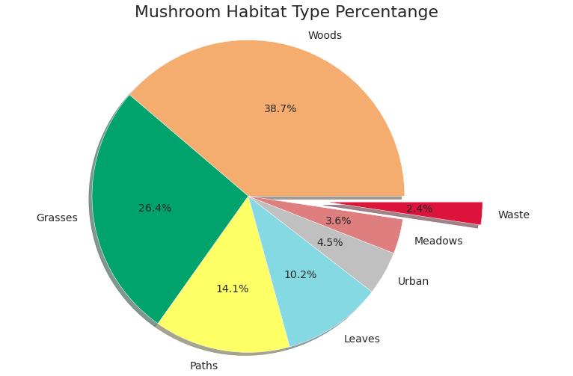

Slide 15
Data Preprocessing
As discussed earlier,since all our columns are encoded in string and are categorical, we Label encoded y - dependent variable (Target)
We have used get dummies instead of one_hot encoding to preserve the names of the columns to do further data exploration and feature selection. One_hot encoding will convert our X data into a numpy array
As a result, we get 95 features to reduce those n features, We are going to use PCA for reducing dimensionality.
After reducing some dimensionalities, We are going to fit those new features to the models and see which one gives best results.

Slide 16
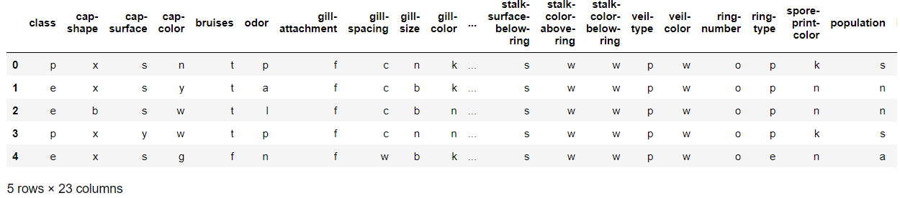
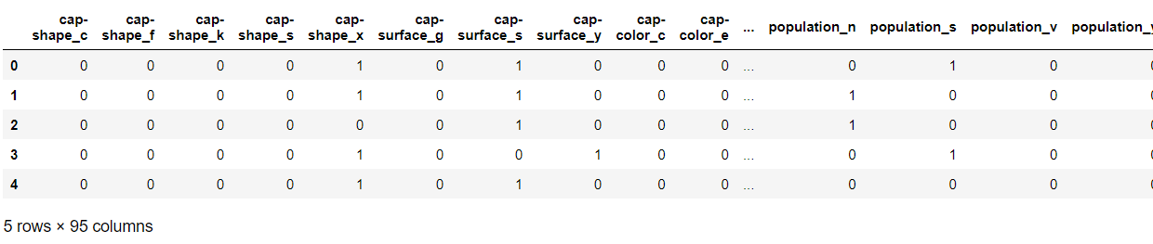
Original Dataset
Dataset after .get_dummies() -> Avoided Dummy Variable Trap

Slide 17
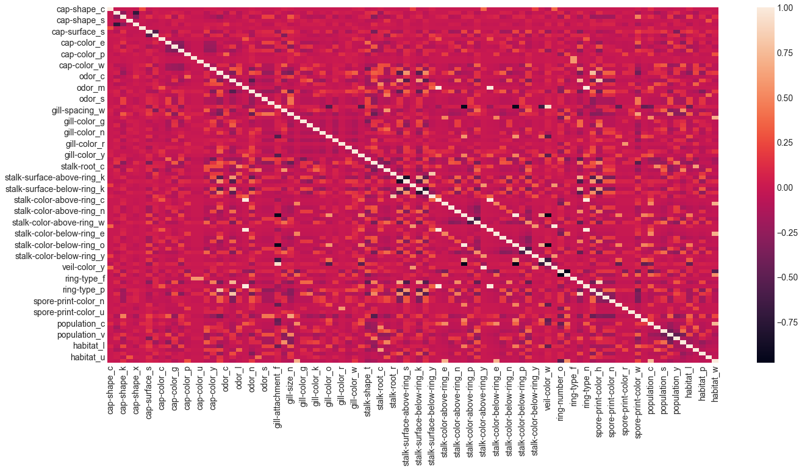
HEATMAP with 95 features

Slide 18
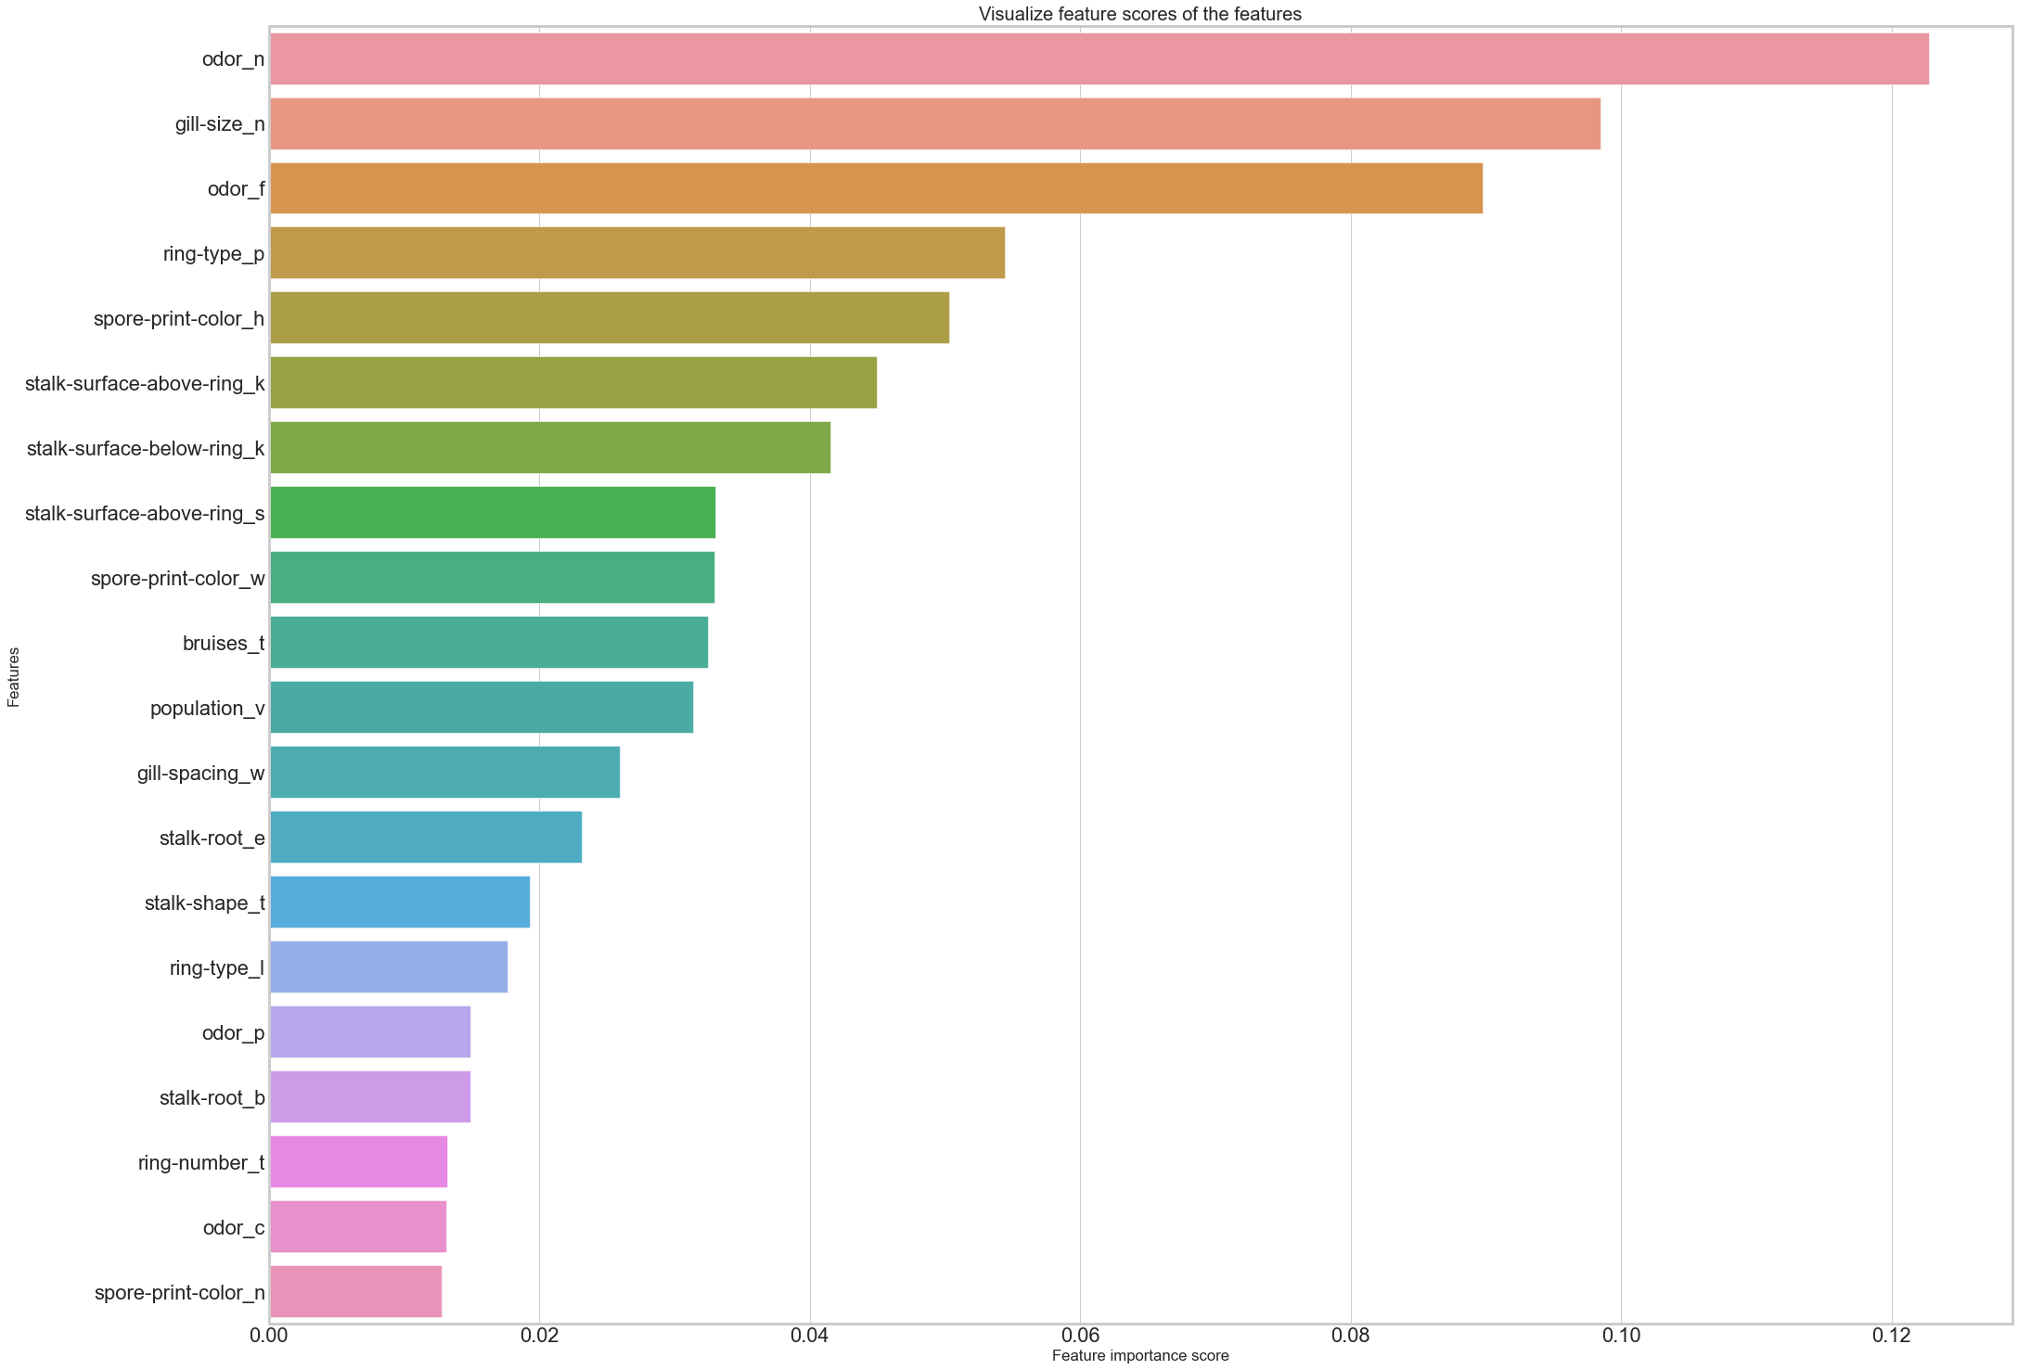
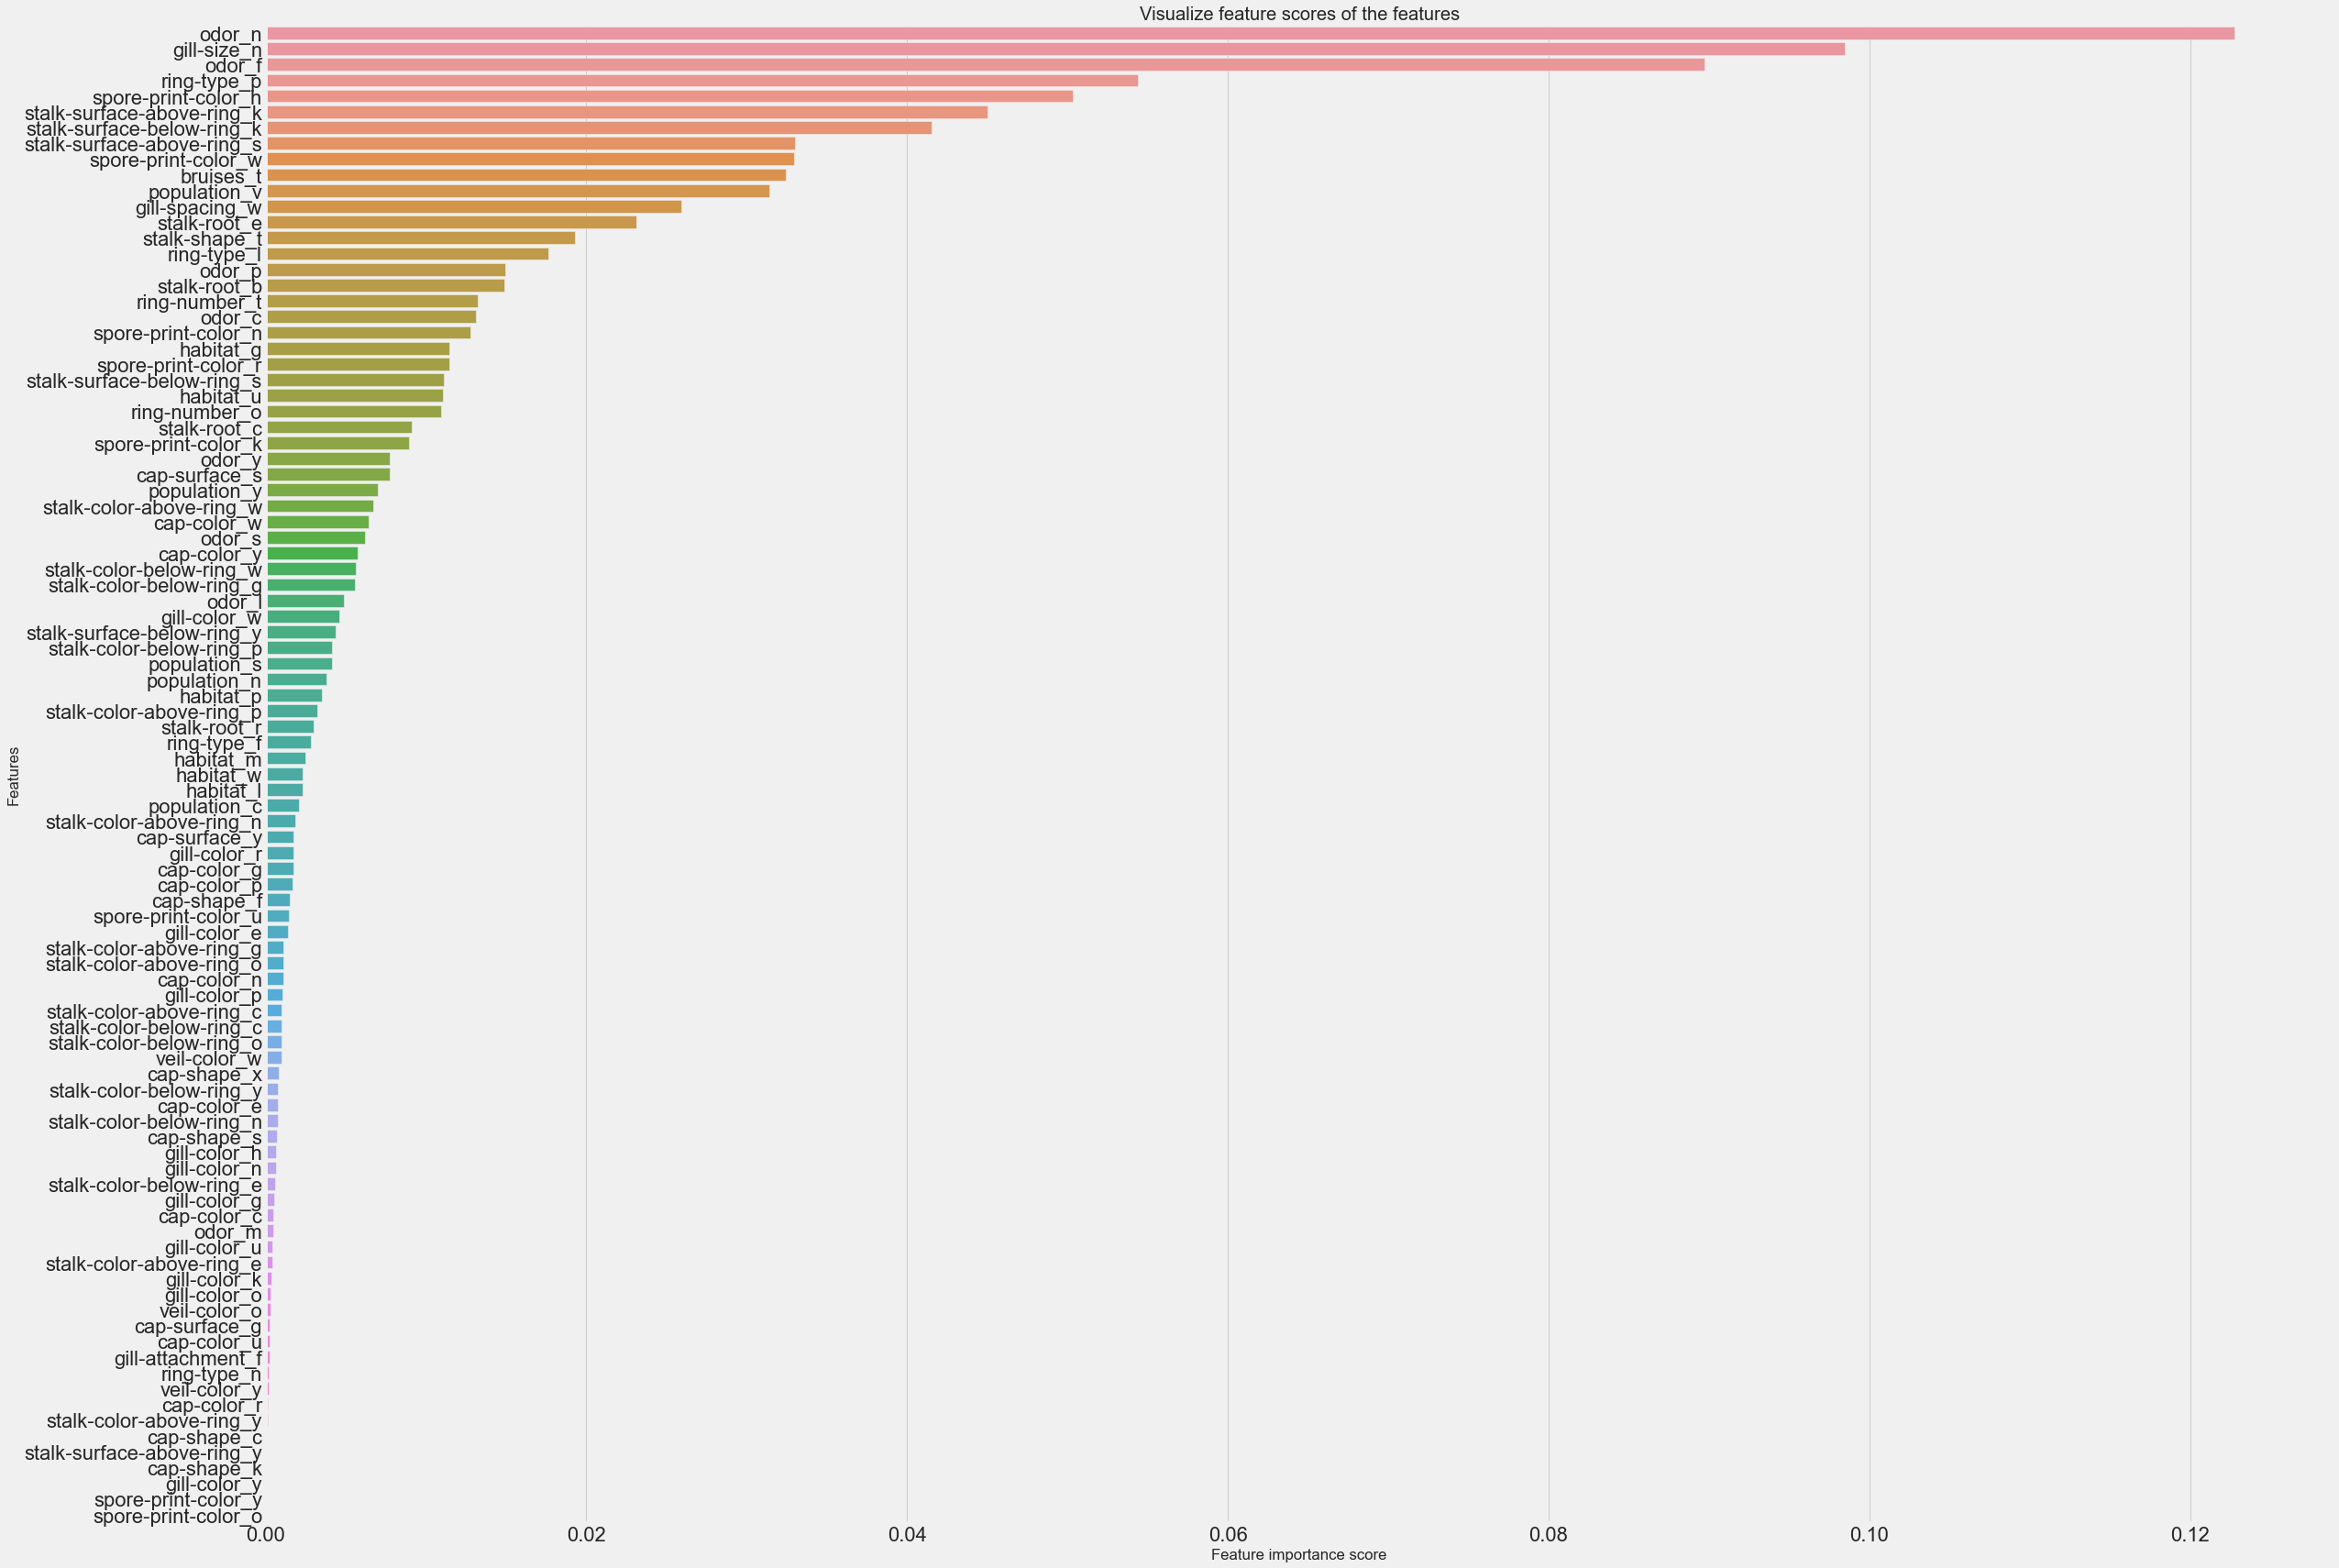
Visualize feature scores of the features
Using RandomForestClassifier we calculated Feature Scores for all the features.

Slide 19
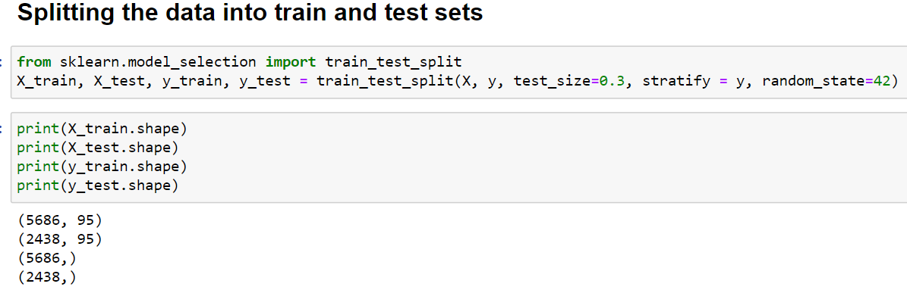
Data splitting
Data splitting is a process used to separate a given dataset into at least two subsets called ‘training’ and ‘test’. This step is usually implemented after data preprocessing. Using train_test_split() from the data science library scikit-learn, the data is split into subsets i.e., training and test which contains 70% and 30% data respectively. This minimizes the potential for bias in the evaluation and validation process. Stratify preserves the same proportions of examples in each class as observed in the original dataset.

Slide 20
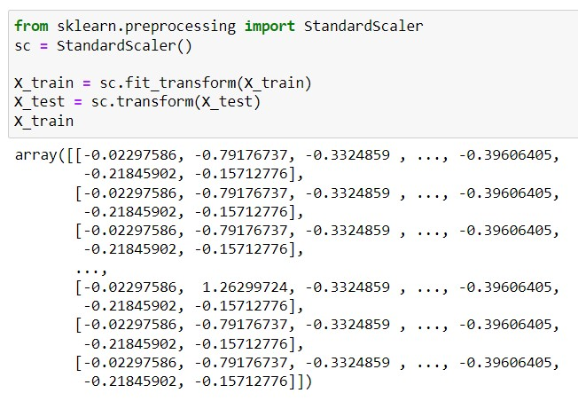
Feature SCALING
Feature Scaling is done to standardize the independent features present in the data in a fixed range. We have used StandardScaler() to perform feature scaling. It performs the task of Standardization. StandardScaler() will normalize the features i.e., each column of X, individually, so that each feature/column will have µ = 0 and σ = 1.
PCA is a technique from linear algebra that can be used to automatically perform dimensionality reduction. Reducing the number of features in a dataset can reduce the risk of overfitting and also improves the accuracy of the model.

Slide 21
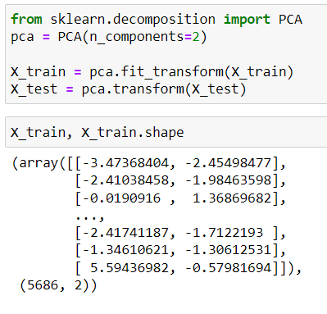
Principal component analysis
The Principal Component Analysis (PCA) algorithm is used to select the best features from the mushroom dataset. PCA is a technique from linear algebra that can be used to automatically perform dimensionality reduction. We have used PCA with n_components = 2 for reducing the dimensions of the dataset.
It is necessary to normalize data before performing PCA. The PCA calculates a new projection of the data set. In normalization of data, all variables have the same standard deviation, thus all variables have the same weight and PCA calculates relevant axis.

Slide 22
PRINCIPAL COMPONENT ANALYSIS
(Contd.)
Perhaps the most popular dimensionality reduction technique in machine learning is Principal Component Analysis.
We needed to tackle the curse of dimensionality (especially with a sparse dataset as ours)
Reducing the number of features in a dataset make our model much simpler, can reduce the risk of overfitting and also improves the accuracy of the model .
Using n_components = 2 allows us to visualize our model performance and plot decision boundaries which helps in increasing interpretability of the model.

Slide 23
Classification Modelling
After the feature extraction and selection, the supervised machine learning methods are applied to the data obtained. The machine learning methods to be applied, as discussed previously, are:
Logistic Regression (LR)
Decision Tree (DT)
Support Vector Machines (SVM)
Random Forest (RF)
Evaluation of the prediction results using various evaluation metrics like AUC-ROC, confusion matrix, classification accuracy, precision, recall, f1-score. is done.

Slide 24
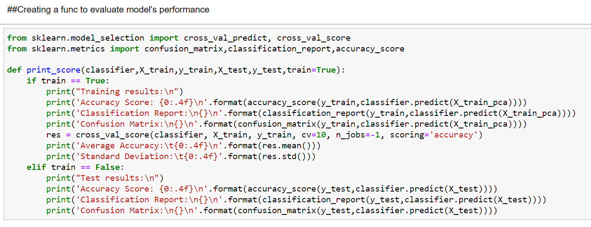
To make it convenient to evaluate model easily, we created a function to push out various Evaluation metrics for various algorithms

Slide 25
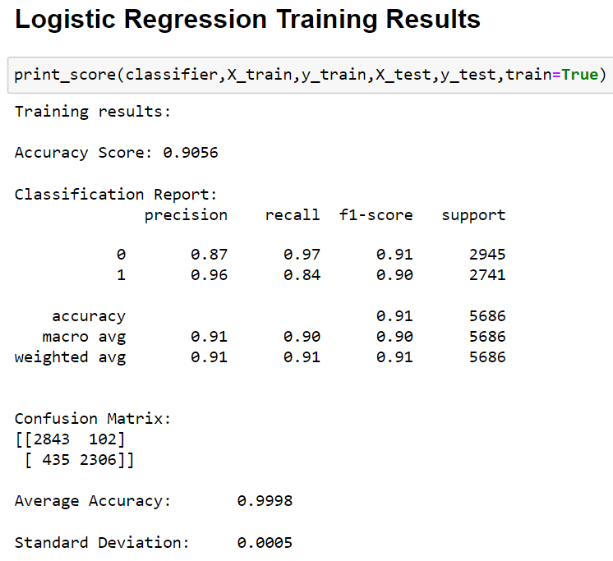
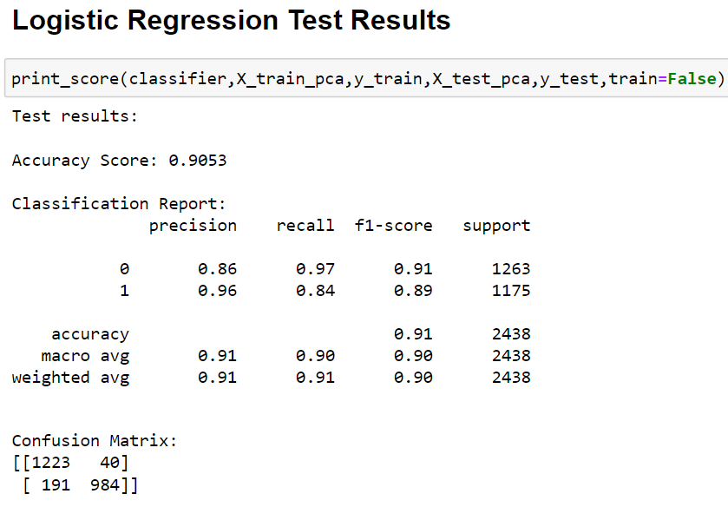
Logistic Regression

Slide 26
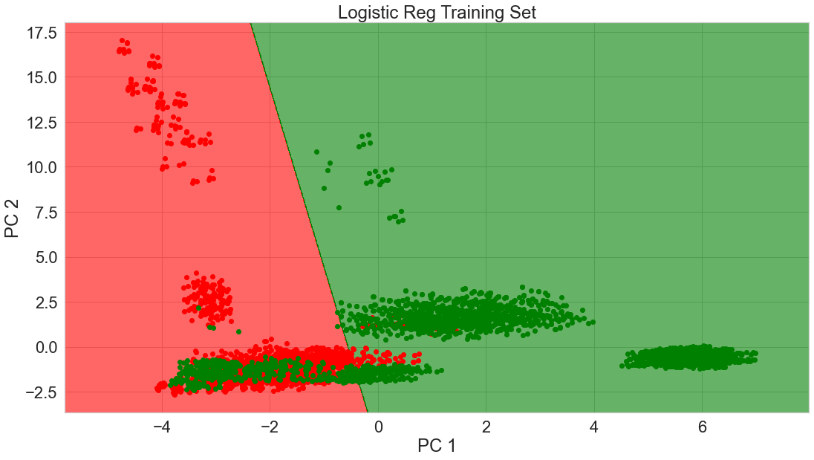


Slide 27
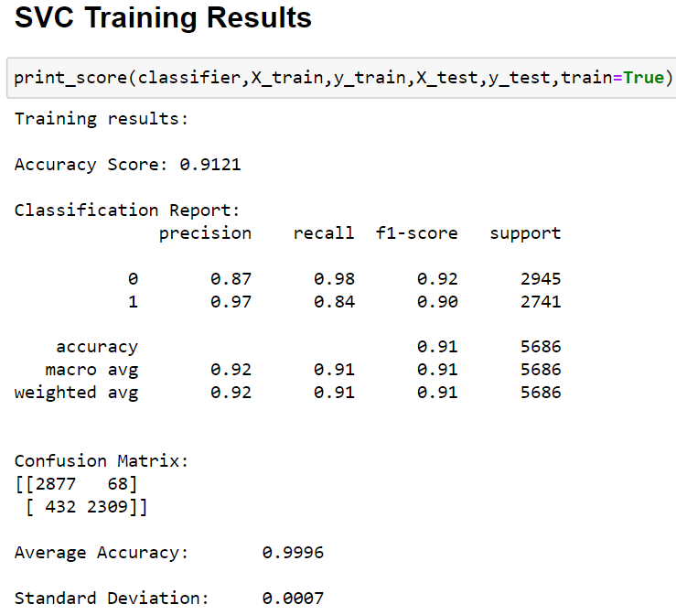
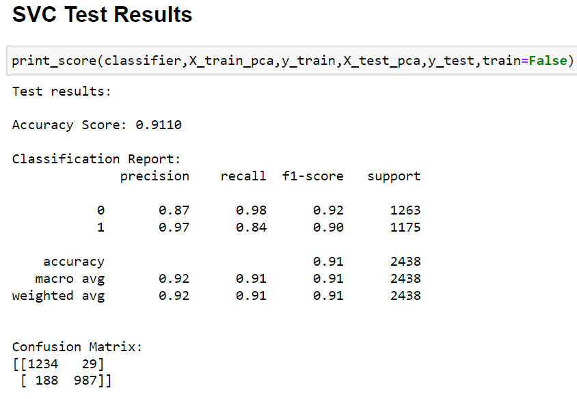
Support Vector (SVC) Classification Model

Slide 28
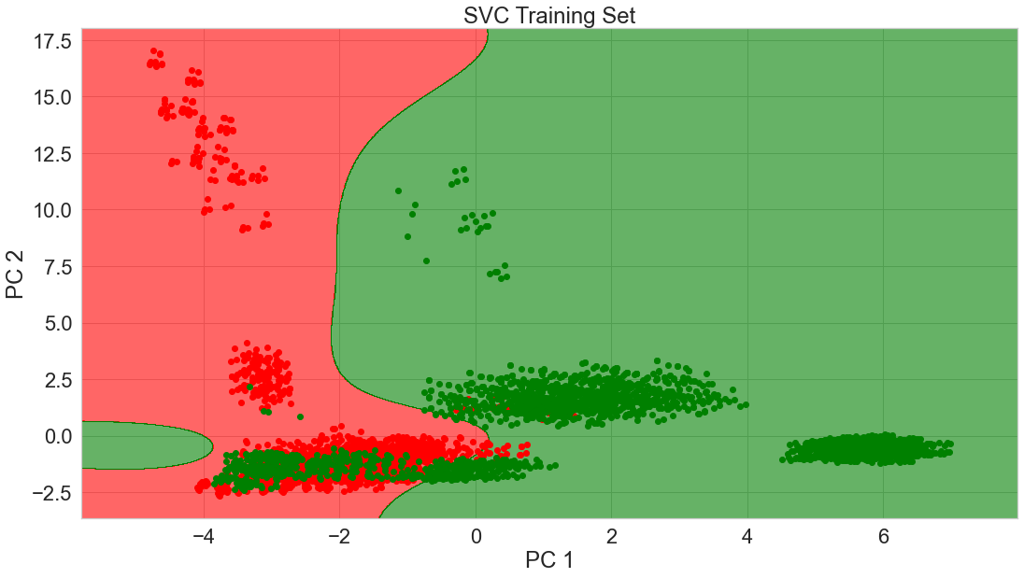


Slide 29
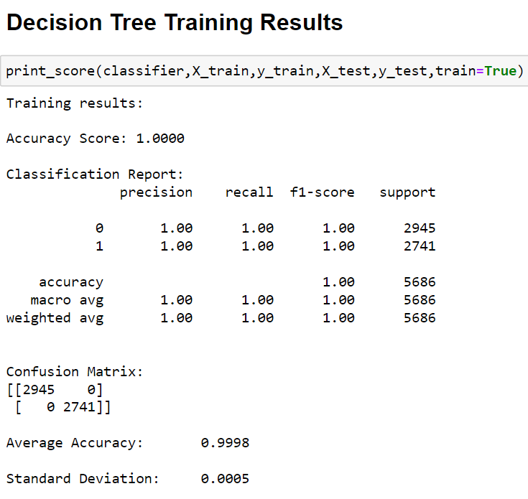
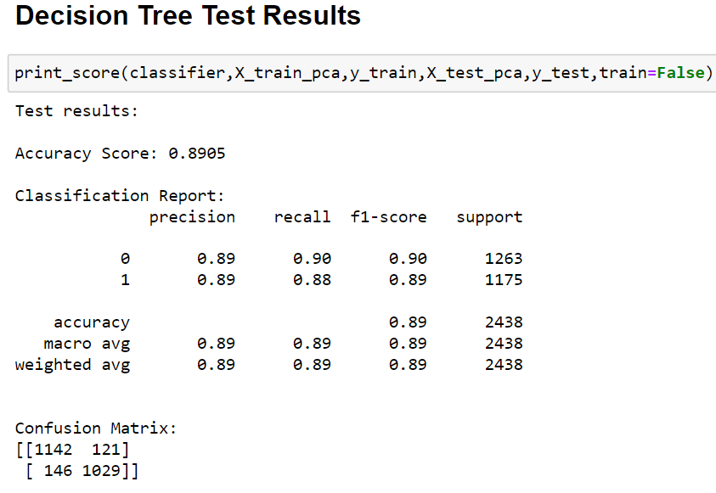
Decision Tree Classification Model

Slide 30


This is a clear case of overfitting as the decision boundary is very refined.
What is the solution to overfitting in a Decision Tree?
A hyperparameter tuned Random Forest should solve this issue for us

Slide 31
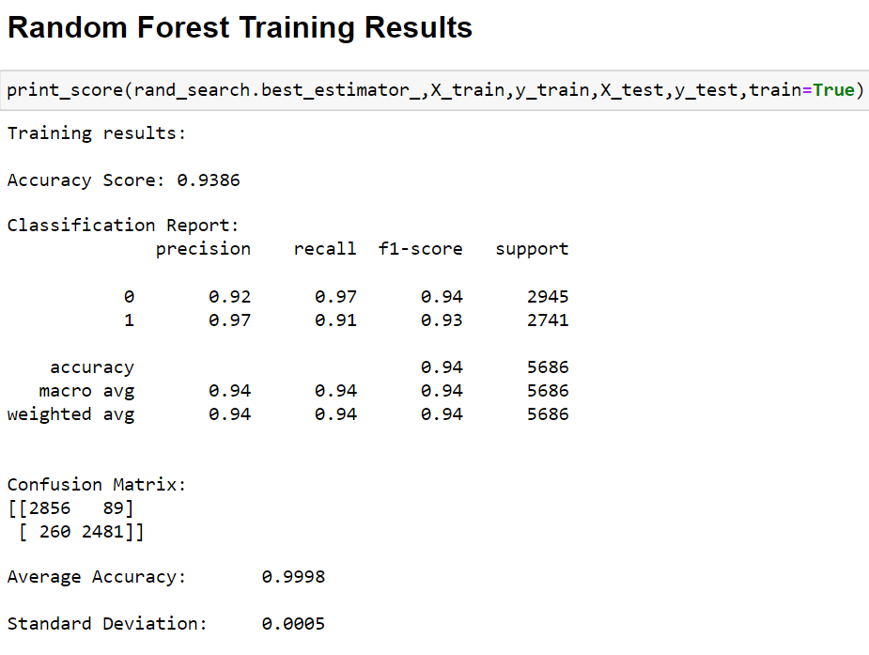
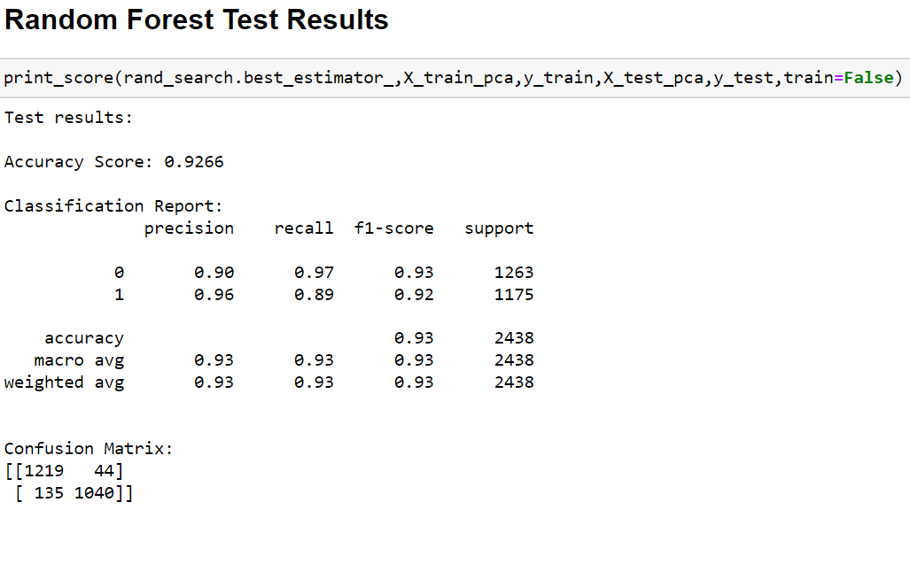
Random Forest Classification Model

Slide 32
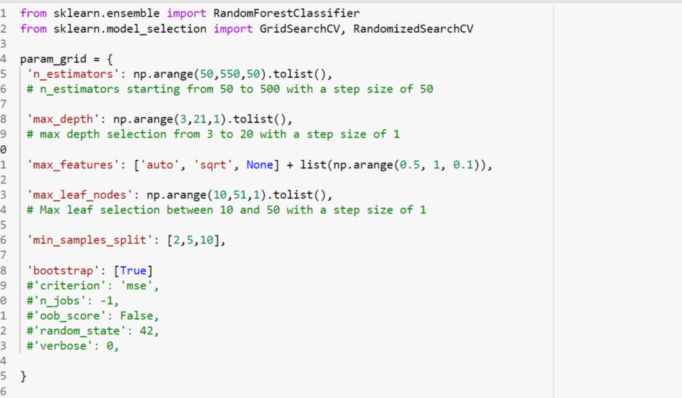
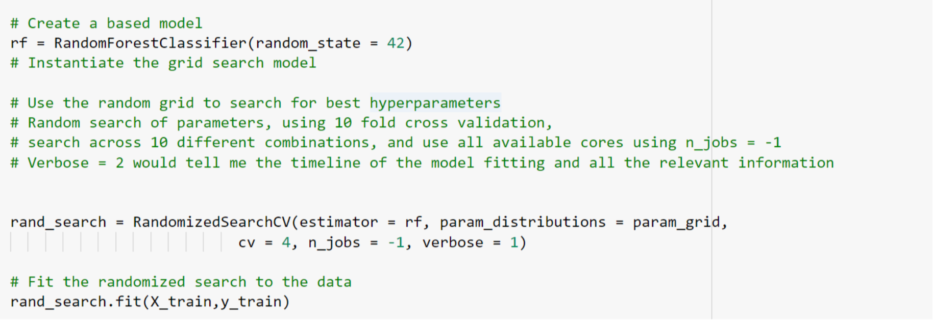
WHY RANDOMIZED SEARCH?
RCV only uses a random search over a specified parameter value, they are faster than GSCV.
RCV can outperform a GSCV, especially if only a small number of hyperparameters affect the performance of the machine learning algorithm.
RCV is also used over GSCV when we have a lot of hyperparameters and using all combinations would be computationally very expensive. For example, Boosted Trees and Neural Networks.

Slide 33
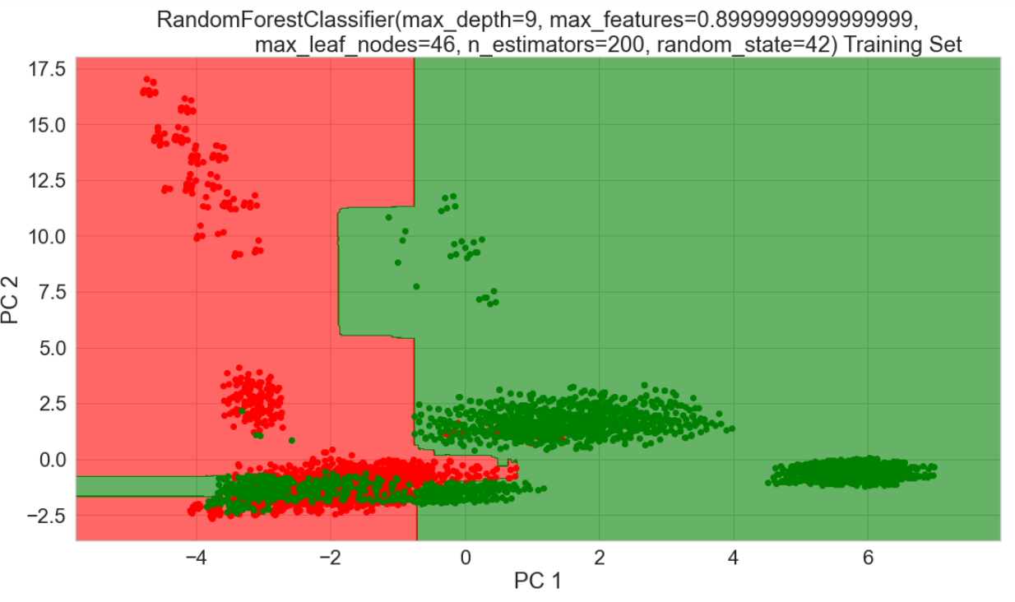
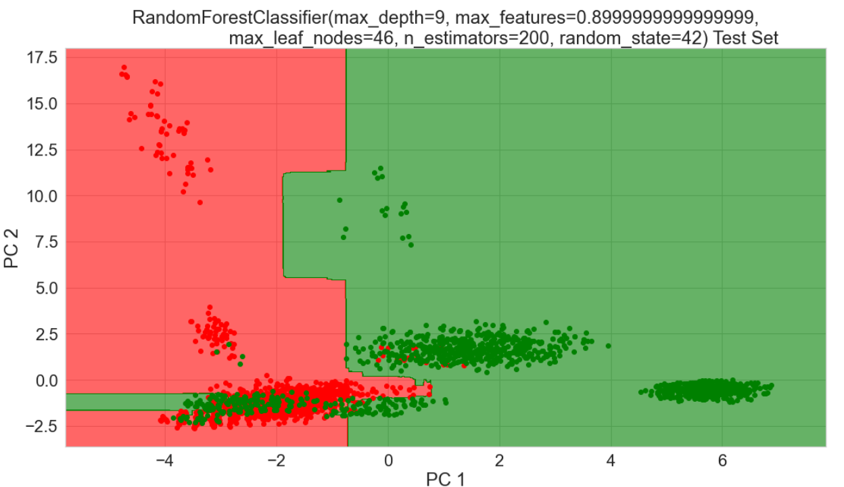

Slide 34
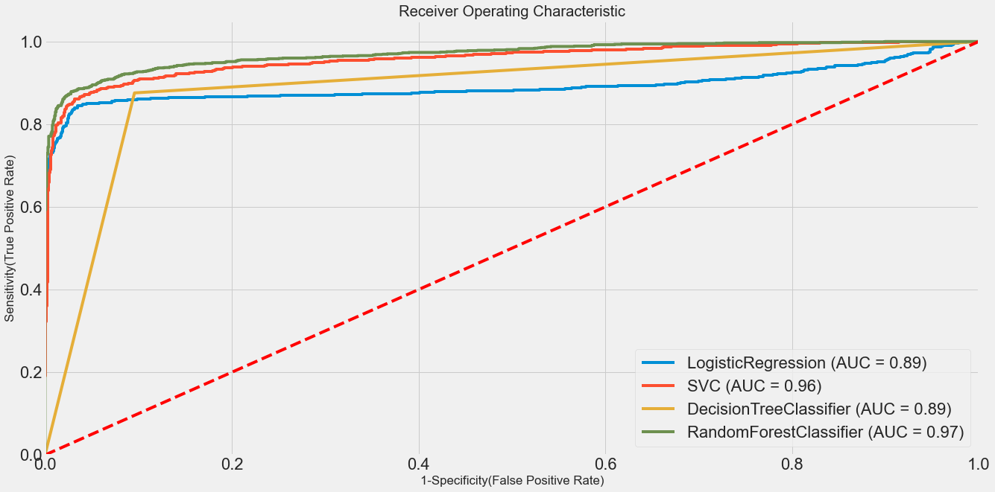
Comparison of ROC-AUC Curve amongst different ML models

Slide 35
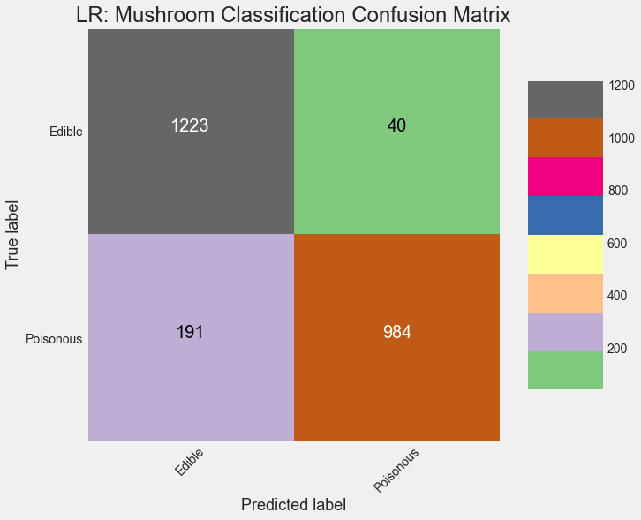

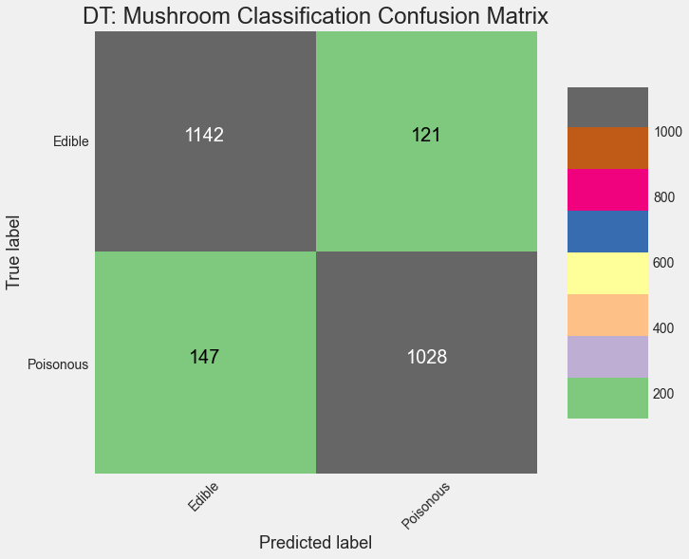
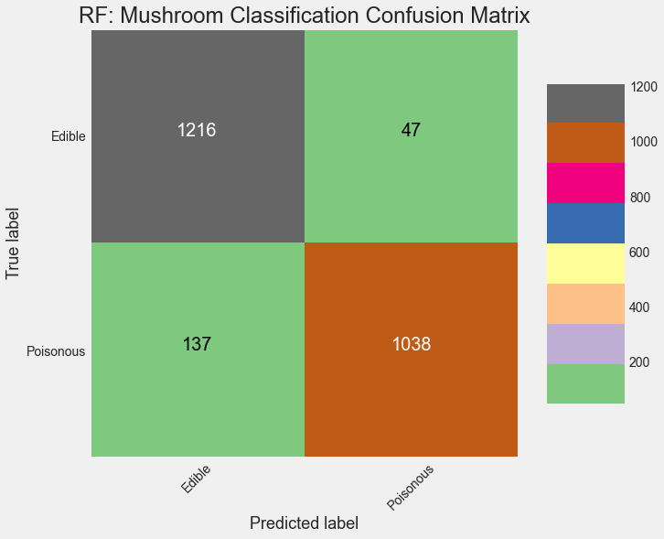
CONFUSION
MATRIX
For Logistic Regression, SVM, Decision Tree and Random Forest Classifier
Actual edible and Predicted edible True Negative | Actual edible and Predicted poisonous False Positive
Actual Poisonous and Predicted edible False Negative | Actual poisonous and Predicted poisonous True Positive

Slide 36
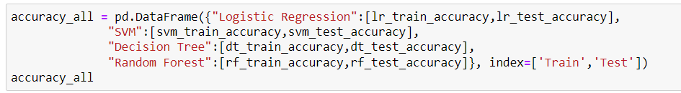
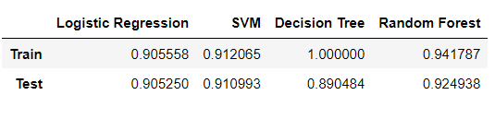
Conclusion
We can see that the hyperparameter tuned Random Forest Classifier works best for Mushroom Classification
Future Scope will be to train a model with OpenCV and CNN's to provide real-time classification as an app to shrooming enthusiast

Slide 37

Thank You

